Slide 1
Computer Architecture Experiment
Topic 4. Pipelined CPU with forwarding
浙江大学计算机学院
陈文智
chenwz@zju.edu.cn

Slide 2
实验操作流程
阅读实验文档，理解支持Forwarding的流水线处理器的实现方式
以前一次实验为基础，为处理器增加Forwarding功能
对处理器进行仿真，检验处理器的仿真结果是否符合要求。
综合工程并下载至开发板，在单步执行的过程中检查调试屏幕的输出，检验处理器的执行过程是否正确。

Slide 3
实验验收标准
仿真执行过程中，处理器的行为和内部控制信号均符合要求。
下载至开发板后的单步执行过程中，寄存器的变化过程和最终执行结果与测试程序相吻合。

Slide 4
Outline
Experiment Purpose
Experiment Task
Basic Principle
Operating Procedures
Precaution
Checkpoints

Slide 5
Experiment Purpose
Understand the principles of Pipelined CPU Bypass Unit
Master the method of Pipelined Pipeline Forwarding Detection and Pipeline Forwards.
Master the Condition In Which Pipeline Forwards.
master methods of program verification of Pipelined CPU with forwarding

Slide 6
Experiment Task
Design the Bypass Unit of Datapath of 5-stages Pipelined CPU
Modify the CPU Controller
Conditions in Which Pipeline Forwards.
Verify the Pipeline CPU with program and observe the execution of program

Slide 7
Data Hazard Stalls
Minimizing Data Hazard Stalls by Forwarding： In most cases, the problem can be resolved by forwarding, also called bypassing, short-circuiting.
Data Hazards Requiring Stalls: In some cases, data hazards can NOT be handled by bypassing.(Next topic)

Slide 8
Instruction Demo

Slide 9
Data Hazard Causes Stalls

Slide 10
Pipeline Forward to Avoid the Data hazard

Slide 11
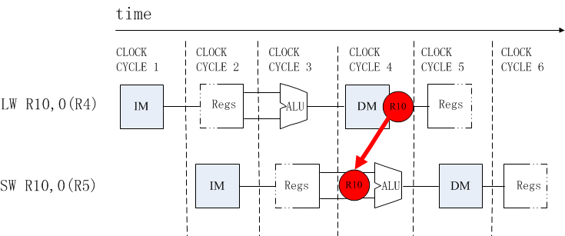
R/I/J-Type After LW

Slide 12
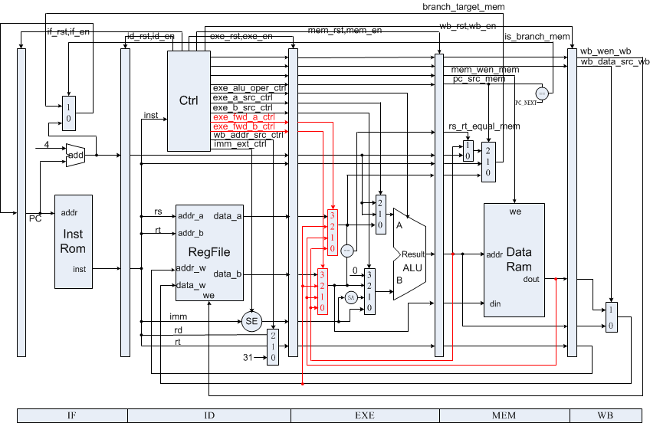
Datapath with Bypass Unit

Slide 13
Controller

Slide 14
Program for verification (1)
00000824 main: and $1, $0, $0 # address of data[0]
34240050 ori $4, $1, 80 # address of data[0]
20050004 call: addi $5, $0, 4 # counter
0c00000a jal sum # call function
ac820000 return: sw $2, 0($4) # store result
8c890000 lw $9, 0($4) # check sw
ac890004 sw $9, 4($4) # store result again
01244022 sub $8, $9, $4 # sub: $8 <- $9 - $4
08000008 finish: j finish # dead loop
00000000 nop # done

Slide 15
Program for verification (2)
00004020 sum: add $8, $0, $0 # sum function entry
8c890000 loop: lw $9, 0($4) # load data
01094020 add $8, $8, $9 # sum
20a5ffff addi $5, $5, -1 # counter - 1
20840004 addi $4, $4, 4 # address + 4
0005182a slt $3, $0, $5 # finish?
1460fffa bne $3, $0, loop # finish?
01001025 or $2, $8, $0 # move result to $v0
03e00008 jr $ra # return
00000000 nop # done

Slide 16
Checkpoints
CP 1: Waveform Simulation of Pipelined CPU with forwarding
CP 2: FPGA Implementation of Pipelined CPU with forwarding with the verification program

Slide 17
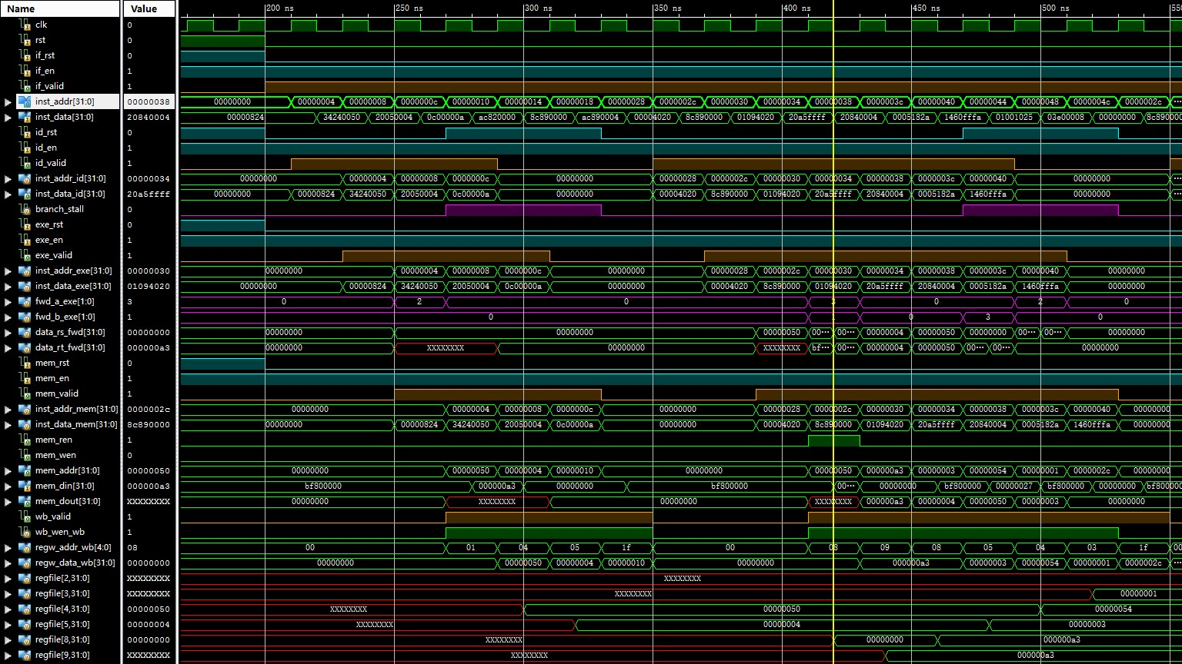
Simulation (1)

Slide 18
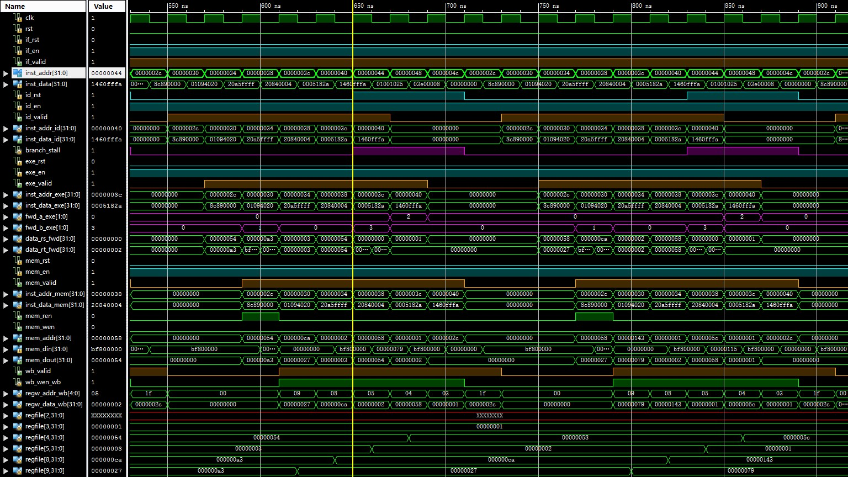
Simulation (2)

Slide 19
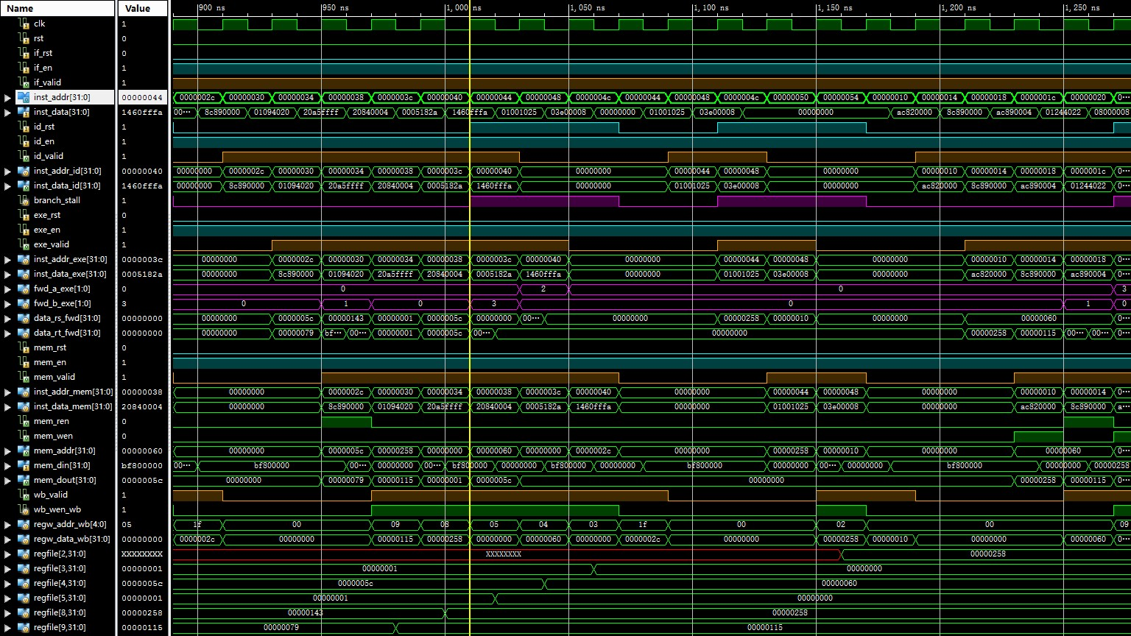
Simulation (3)

Slide 20
Thanks!

